Slide 1
Behaviorism:
A framework for dynamic
data visualization
Angus Forbes, Tobias Höllerer, George Legrady
Media Arts & Technology
Experimental Visualization Lab
Imaging, Interaction, Innovative Interfaces Lab
University of California at Santa Barbara

Slide 2
Behaviorism
is a programming framework
for creating information visualization projects,
especially ones
that use dynamic data.

Slide 3
Overview/Background
Design decisions
Architecture
Conclusion/Future

Slide 4
The Behaviorism framework
simplifies the creation of visualization projects
by providing tools
to collect, manage, and render data,
without sacrificing
robustness or flexibility.

Slide 5
Behaviorism makes it easy to create
interactive graphics and animations
using
a hardware-accelerated OpenGL renderer,
a flexible scene graph,
and
a set of customizable graphics and media objects.

Slide 6
Behaviorism handles streams
of complex, heterogeneous data.
Data is stored in a graph structure
which can be connected with semantic links
and updated dynamically.
Extensible tools are provided which can be used
to collect, parse, integrate data,
and also to analyze data.

Slide 7
Why another framework?
To fill the niche between media arts frameworks
and info visualization frameworks
by providing tools for both
modeling / managing data and rendering
Easy to turn prototypes into robust systems

Slide 8
A unified set of Behavior objects are used to model various aspects of the visualization project.
Behavior objects are extensible, concurrent controllers
which handle the logic and timing of
data collection and data integration processes,
graphical layout and animation of data,
and
the effects of user interaction.

Slide 9
As a simple example,
a Behavior could schedule a visual element to get larger
in response to a mouse click...
or a Behavior could trigger an analysis of collected data at scheduled intervals...

Slide 10
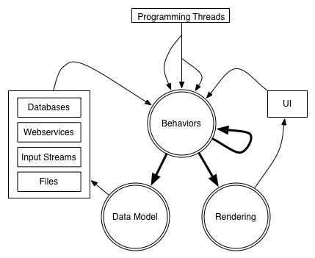

Slide 11
Overview/Background
Design decisions
Architecture
Conclusion/Future

Slide 12
Cell Tango - George Legrady and Angus Forbes
w/Christopher Jette
Projected multimedia installation
of user-submitted cellphone photography
and tagged photos from Flickr.com.
Currently installed in Poznan, Poland as part of a media biennale.

Slide 13
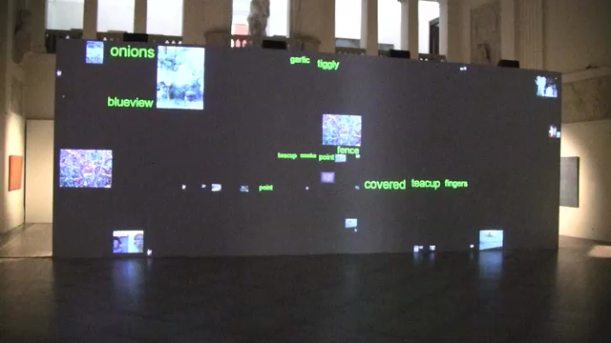

Slide 14
Behaviorism
supports incoming data from various external data streams
supports robust multimedia installations
animation is easy to program and synchronize

Slide 15
Tag River - Basak Alper and Angus Forbes
An interactive information visualization project
utilizing data from Last.fm
showing listening trends over time.
Hybrid of theme river / tag clouds.
Two modes: interactive and ambient

Slide 16
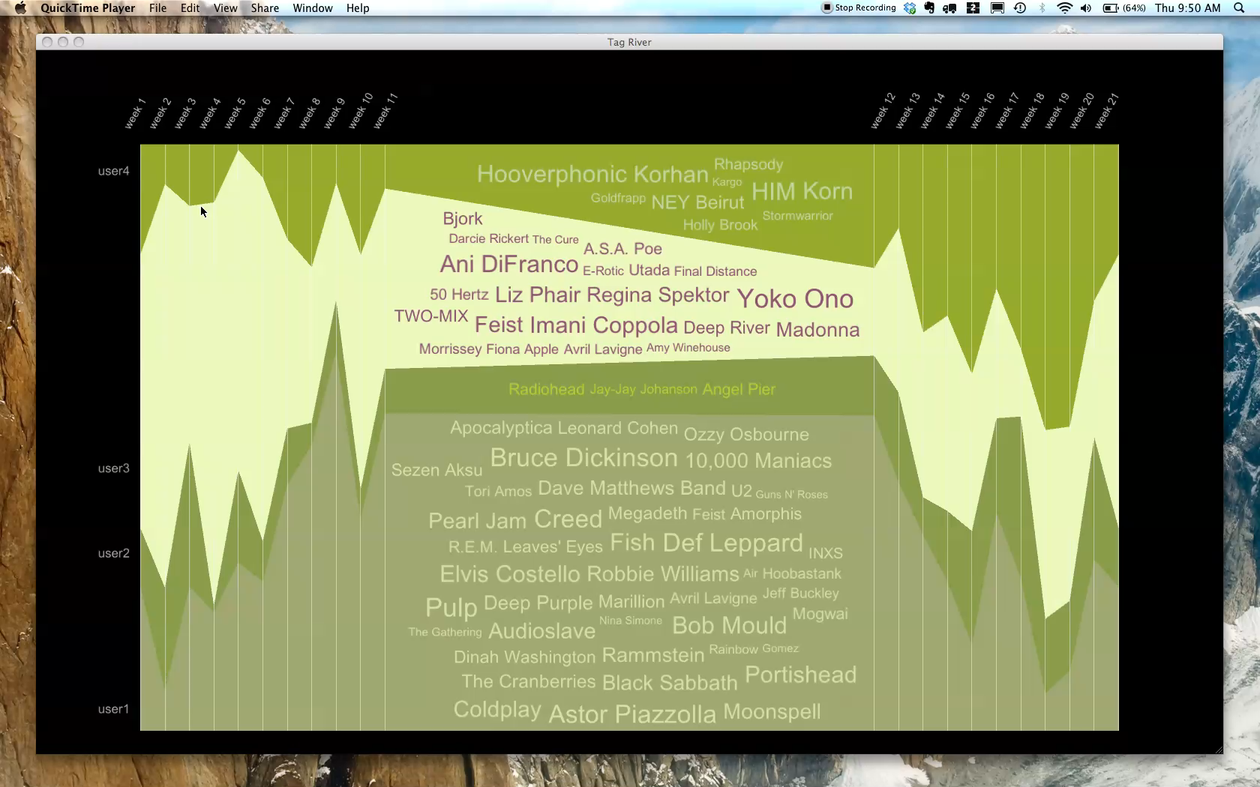

Slide 17
Behaviorism
supports desktop information visualization projects
can manage both user interaction threads and programmatically defined animation threads
easy to create visual metaphors

Slide 18
Overview/Background
Design decisions
Architecture
Conclusion/Future

Slide 19
Architecture of framework is segmented
into 3 main areas:
Rendering (Geoms) - Scene Graph
Data Operations (Nodes) - Data Graph
Scheduling and Control (Behaviors) - Timing Graph

Slide 20
The rendering of geometry is split into two sections:
1. The scene graph is traversed, the modelview of each Geom is calculated, and then the Geom is placed within a particular RenderLayer.
2. Each RenderLayer is sorted and traversed, lighting, material, blending, and other state is set, shaders are bounds, and then each Geom is rendered using OpenGL commands.

Slide 21
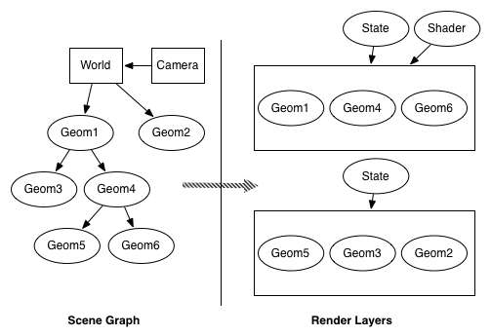

Slide 22
Data Graph
All data used in the visualization project has an internal representation or proxy on the Data Graph.
The Data Graph is heterogeneous, semantic,
traversable, filterable, analyzable, and dynamic.

Slide 23
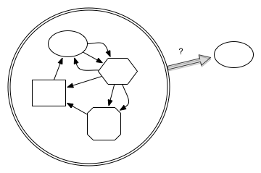
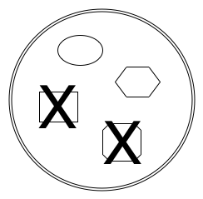
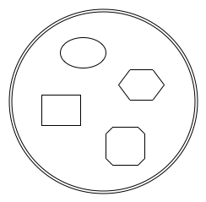
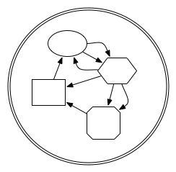
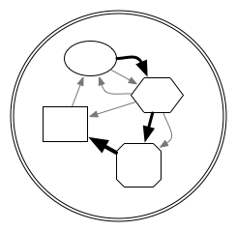
heterogeneous
semantic
analyze
filter
traverse

Slide 24
The data graph is conceived of as a dynamic entity,
which can constantly change
due to incoming streams of data,
programmatic additions and deletions,
or in response to user-interaction.

Slide 25
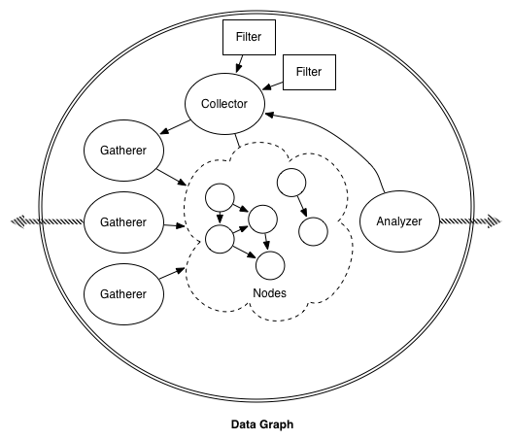

Slide 26
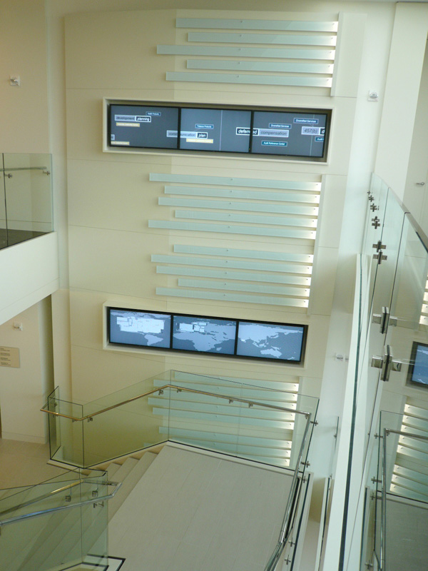
Data Flow - George Legrady and Angus Forbes
A 3x3-panel data visualization installation
displaying a series of real-time statistics for a corporate website.

Slide 27
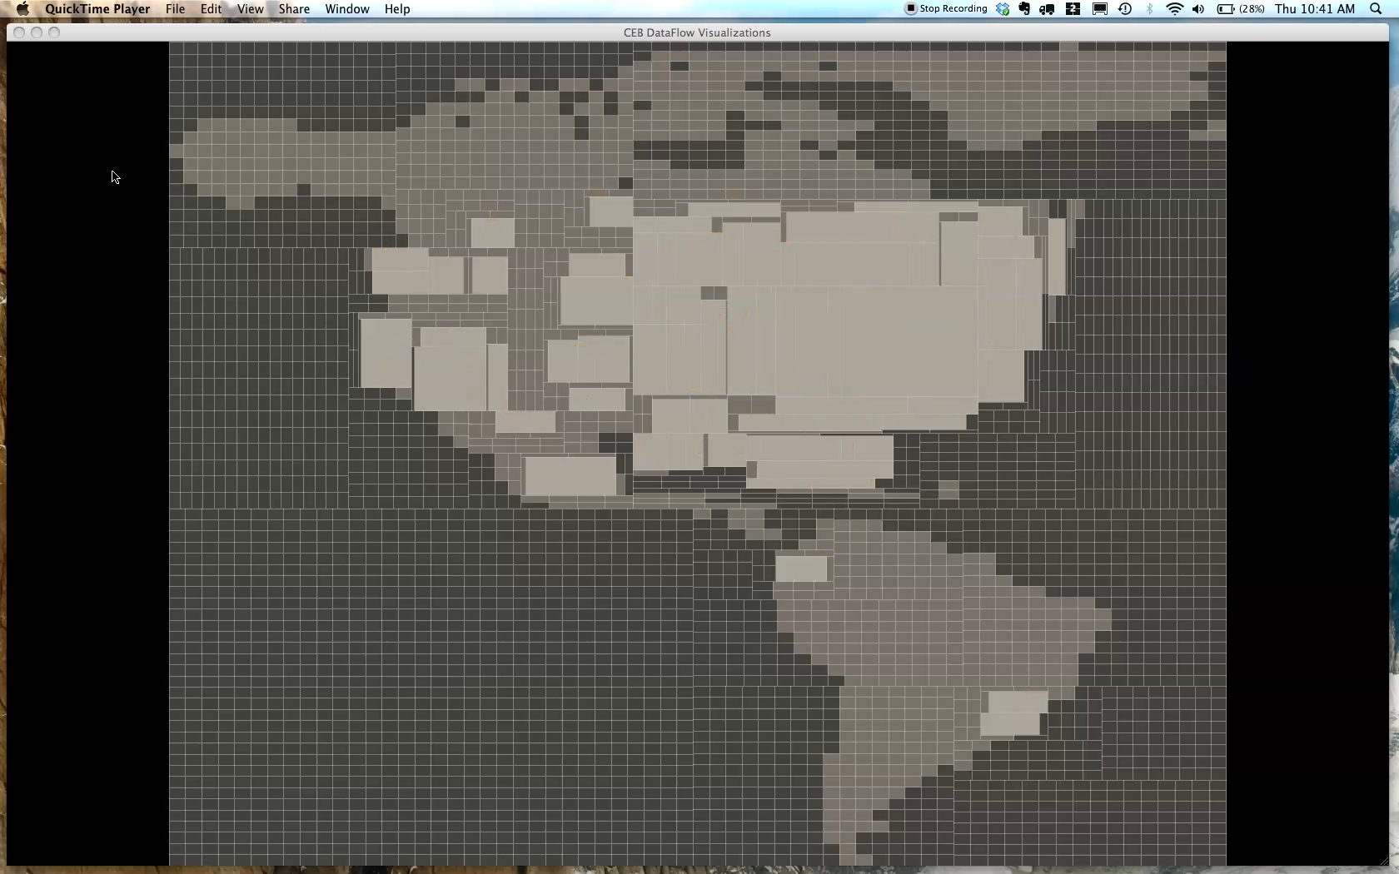

Slide 28
Behaviorism
makes it easy to gather, parse, filter, and analyze data.
This project handled up to 100,000+ events per hour at peak times of the day.
No longer active, but ran for one year at a corporate headquarters in DC.

Slide 29
Timing Graph (Scheduler)
The Timing Graph contains Behavior objects which control the flow of the visualization system:
scheduling the gathering and analysis of data,
creating and deleting Geoms,
controlling animation, attribute updates, and state changes,
responding to user-interaction
and updating other Behaviors

Slide 30
Each Behavior is responsible for executing some logic which effects one or more items on the Scene Graph, the Data Graph, or the Timing Graph itself.
Behaviors provide a uniform interface for safe updates to the underlying concurrent data structures.

Slide 31
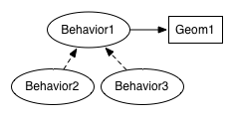
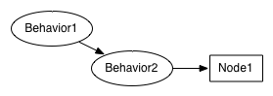
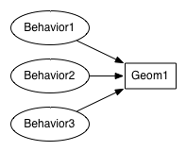
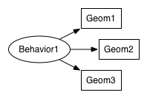
Stackable
Relative
Chainable
Mutable

Slide 32
Coil Maps - Angus Forbes
An interactive visualization project
that lets users browse archival photography
which is stored in an animated grid of cells.

Slide 33
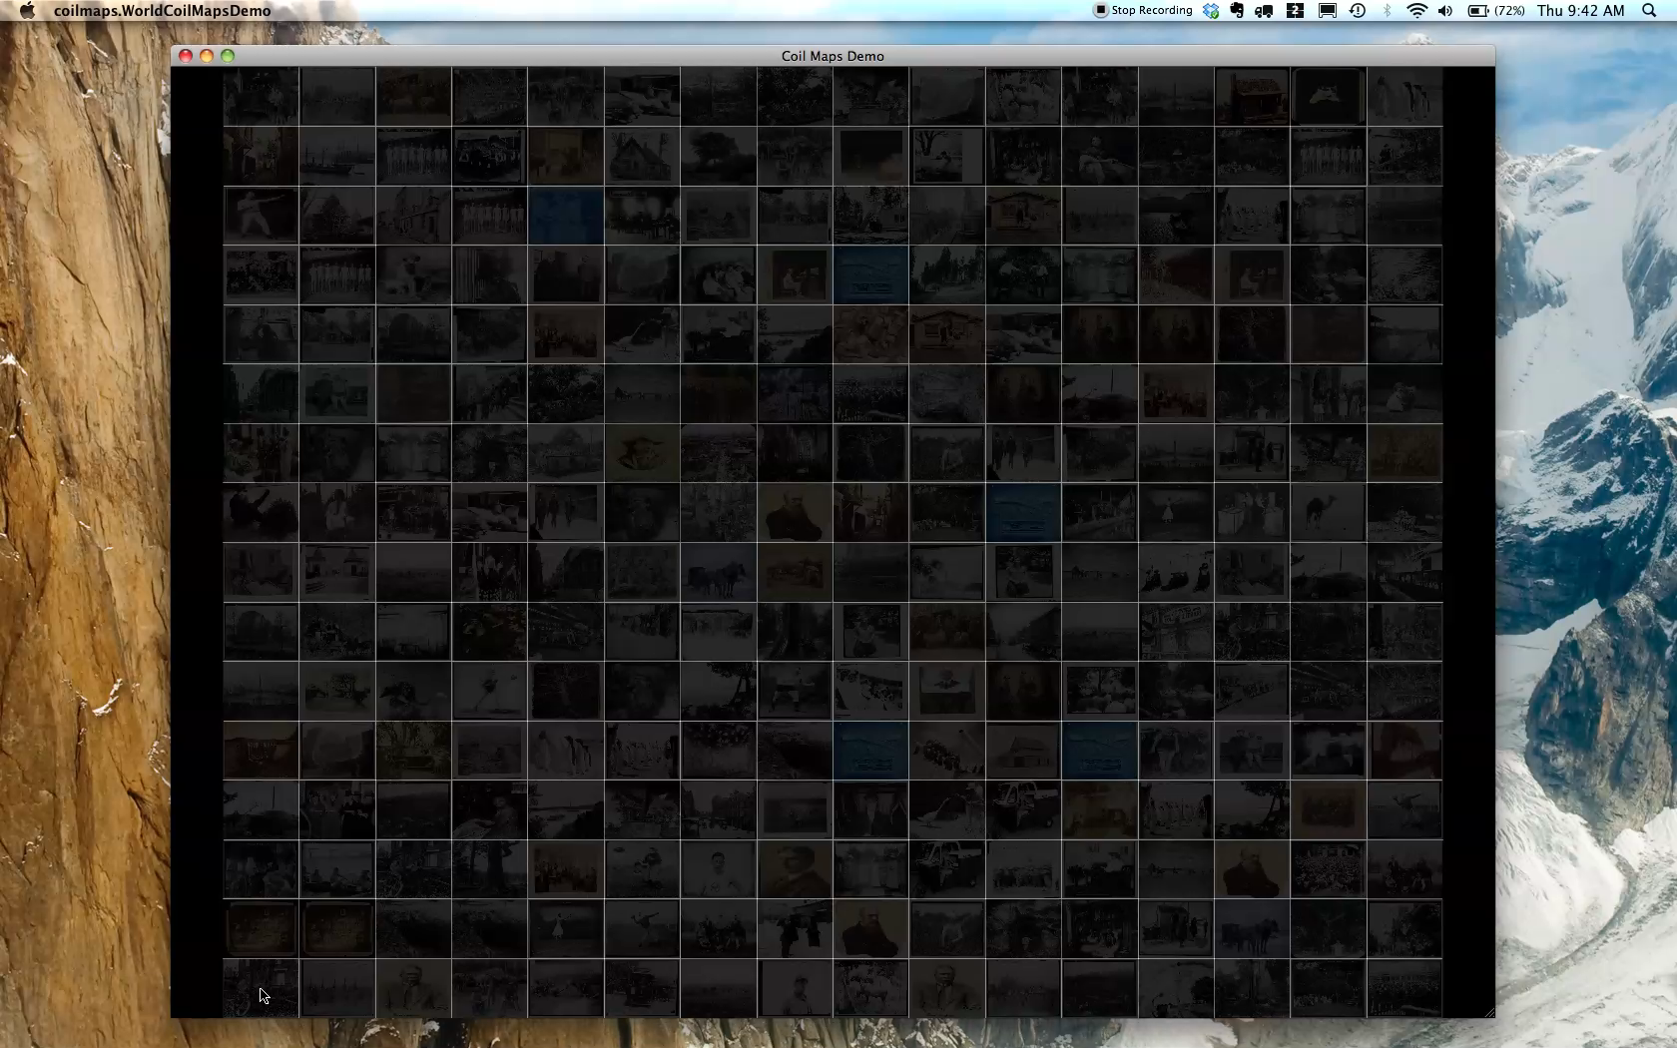

Slide 34
Discrete Behaviors run once at a specified time, or repeatedly at set intervals.
They control such things as:
triggering a data gathering event;
how often a data analysis should be performed;
changing the state of Geom objects;
adding or deleting elements from the system.
After they are executed, they can reschedule themselves.

Slide 35
Continuous Behaviors run continuously between a specified start and end time.
They control such things as:
changing the location or attributes of a Geom;
changing the values of a data Node;
changing the speed of an animation;
altering the effect of another Behavior.

Slide 36
Each continuous Behavior updates itself at the same speed as the display refresh rate (ie. appx. 60fps) and interpolates the change in value across its defined range.
Various easing functions can be attached to the Behavior to change the way an attribute is interpolated across this range (linear interpolation is the default).

Slide 37
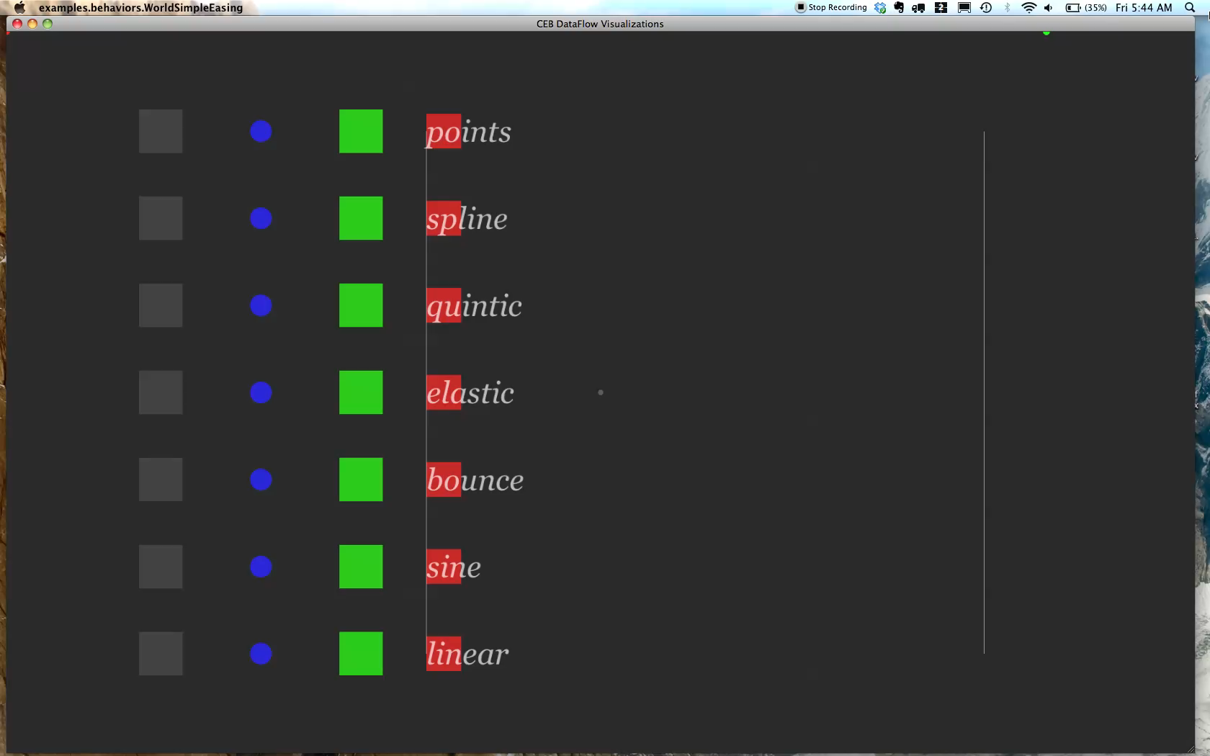

Slide 38
/***
Attaching a repeating animation Behavior with easing to a Geom.
***/
//create a simple Geom
Geom g = new GeomRect(new Point3f(), 1f, 1f);
//create and schedule animation behavior
BehaviorTranslate bt = new BehaviorTranslate(
new ContinuousBehaviorBuilder(Utils.now(), 5000L)
.isReversing(true)
.repeats(3)
.easing(new EasingPolynomial(OUT, 5);
.ranges(+3f,0f,0f);
Scheduler.getInstance().attachGeom(bt, g);
//attach the Geom to the SceneGraph
addGeom(g);

Slide 39
/*** Attaching a animation Behavior to a Geom ***/
//create a new Geom
Geom g = new GeomRect(new Point3f(), 1f, 1f);
//create a translation animation Behavior
Behavior bt = BehaviorTranslate.translate(
Utils.nowPlusMillis(10000L), 5000L, new Point3f(3f, 0f, 0f));
//attach the Behavior to the Geom
Scheduler.getInstance().attachGeom(bt, g);
//attach the Geom to the SceneGraph
addGeom(g);

Slide 40
/*** Behavior updating another Behavior ***/
long baseTime = Utils.nowPlusMillis(10000L);
//create a new Geom
Geom g = new GeomRect(new Point3f(), 1f, 1f);
//create a translation animation Behavior
Behavior bt = BehaviorTranslate.translate(
baseTime, 5000L, new Point3f(3f, 0f, 0f));
//attach the Behavior to the Geom
Scheduler.getInstance().attachGeom(bt, g);
//create a Behavior that speeds up the animation Behavior
Behvaior bs = new BehaviorSpeed(Utils.nanoPlusMillis(2500L), 2f);
//attach the Geom to the SceneGraph
addGeom(g);

Slide 41
Overview/Background
Design decisions
Architecture
Conclusion/Future

Slide 42
Behaviorism is a useful framework for creating a wide variety of robust media arts and information visualization projects.
In particular, it is well suited to the iterative prototyping of models of dynamic data representation, visual metaphors, and interaction techniques.
More details about the architecture of the framework are in the tvcg paper.

Slide 43
future directions
to use this framework on more projects...
to have more users use the framework...
integrate the data model and behaviors into other systems (Processing? openFrameworks?)...
rewrite Behaviorism in Scala...? use dedicated graph db...?
webGL/HTML5...?
to do further evaluation of the framework (in both media arts usage and for information visualization programming tasks)...
still in the process of conducting long term media arts usage studies...

Slide 44
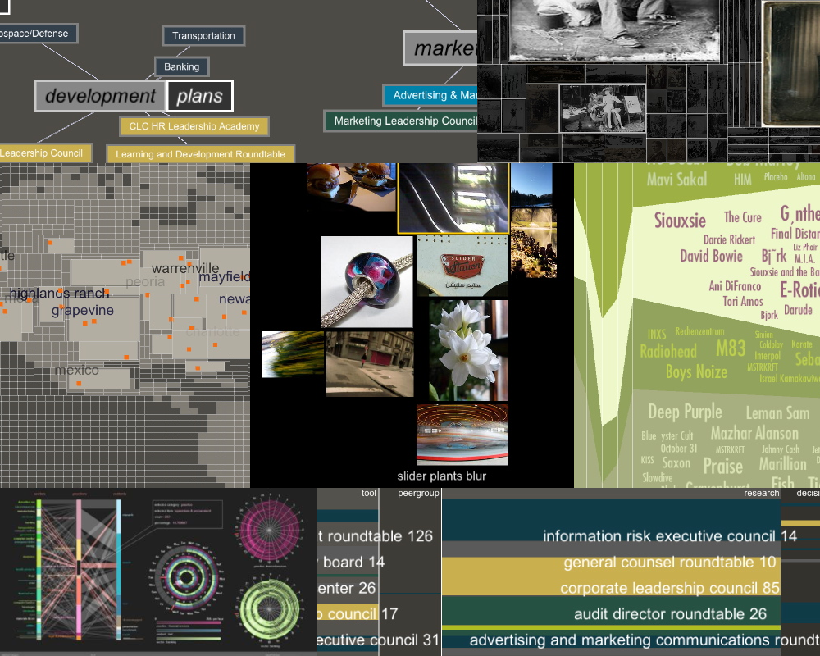
Thanks!
Question, etc? email angus.forbes@mat.ucsb.edu
code available at http://github.com/angusforbes/behaviorism
(new version will be pushed to public repo soon!)

